Slide 1

IMDB MOVIE
ANALYSIS
By - Vishal Tyagi

Slide 2
Project Description : IMDB Movie Analysis
We are having a dataset of different IMDB Movies in which we have 28 columns and 5044 rows .
Explore the Data set and derive insights.
Drop the unnecessary columns and remove the null values from the dataset.
Create pivot chart and pivot tables to answer given questions.
Give answer to asked questions and create reports and graphs for given queries.

Slide 3

Approach:
Firstly, Open the data in excel and go through the dataset to know more about the data, tables, columns and the rows.
Analyze the data given of employees to do further excel operations.
Use excel to analyze data using filter, sorting, conditional formatting, pivot table and pivot chart to answer asked questions.
Solve the given problems in the questions.

Slide 4

Tech-Stack Used:
Excel
Power Point
Google Drive
Jupyter
These Software Provides better data security, more in-built functions and on demand scalability.

Slide 5

Insights:
While making this project I learnt about the Excel, how to analyze data or how to use some inbuilt functions to do some operations on the data.
I got a good exposure about Excel, how Excel and the functions of Excel can be used in analyzing the data from the dataset, most important I got to know more about Pivot table and Pivot charts which helps me a lot in finding the required output from the data.
You need to understand and analyze the dataset to find desired and accurate output from the data.

Slide 6

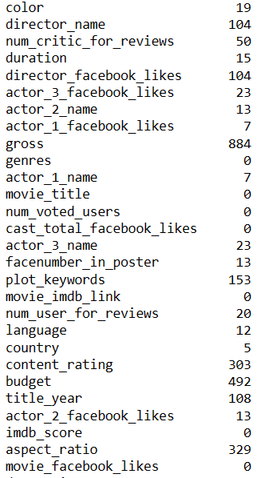
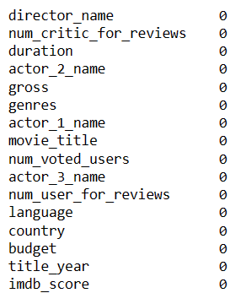
Results:
Ques-A: Cleaning the Data?
Count of null values present
in each column :
After dropping null values and unnecessary columns from the data frame :

Slide 7
Ques – B: Find the movies with the highest profit.
Top 20 Highest Profit Movies

Slide 8
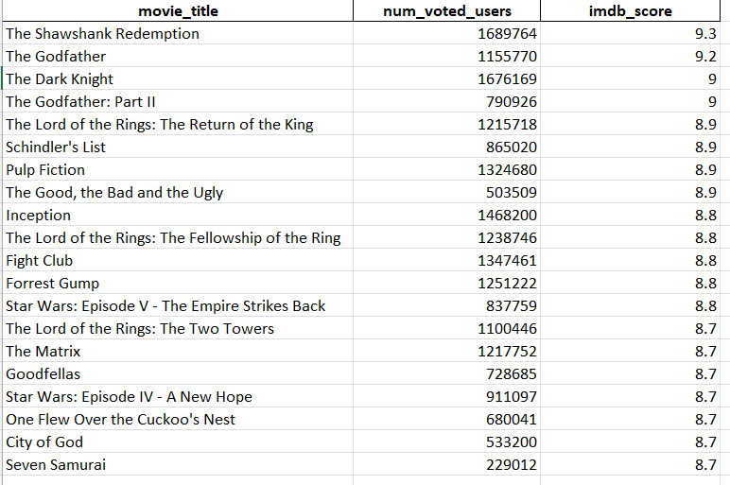
Ques – C: Movies with num_voted_users greater than 25,000 and highest IMDb Rating score.

Slide 9
Ques – D: Find the best directors.

Slide 10
Ques – E: Find Popular Genres.

Slide 11
Ques – E : Find the critic-favorite and audience-favorite actors.
Leonardo DiCaprio has highest mean value as per Critic reviews and audience reviews.

Slide 12
Sum of users voted in each decade.
During 2000 to 2010 there is highest number of Voted users.

Slide 13
Thankyou…

